Slide 1

AIRPORT
AIRLINE
RELATIONSHIP
By:
WG CDR K VENUGOPAL (RETD)

Slide 2
COMMON ISSUES
Customer is the “KING”
Handling diverse service providers and users
Multicultural/ Multilingual nature of passengers
Need for synergy
Use of ICT
Need for less physical coordination
Unruly behavior
Trespass
Breach of security
Demand for slots and facilities like aerobridges and conveyer belts

Slide 3
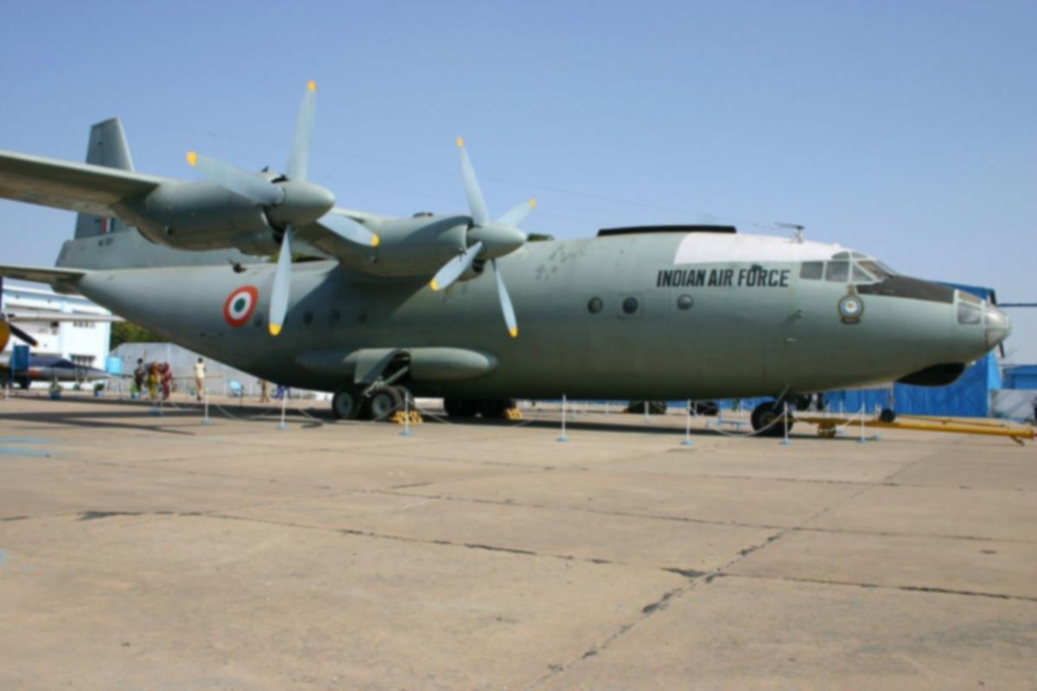
AIRFORCE AIRPORT
HEAD
COMMON CAUSE: SAFE FLYING ENVIRONMENT FOR MISSION ACCOMPLISHMENT
Flying Units
OPS
Maint
Admn
Safety, ATC, Met
Maints
Com/ Nav
Civil Works/ Construction
HR
Finance

Slide 4
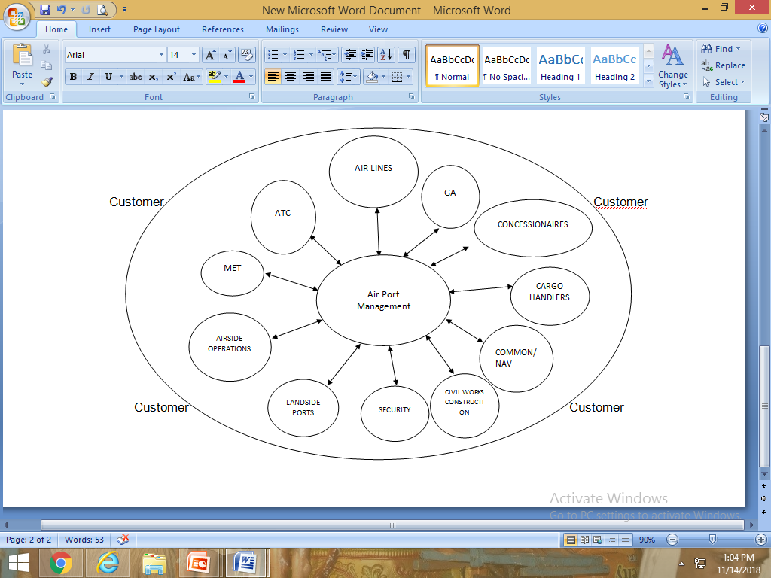
MODERN COMMERCIAL AIRPORT
COMMON CAUSE: SAFETY, ECONOMIC VIABILITY ARE PRIME FOCUS WITH PASSENGERS SATISFACTION

Slide 5
FACTORS IN AIRPORT-AIRLINE RELATIONSHIP
Costing of service
Airline
Non-Airline
Rents and Fees
Meaningful impact on the size of the local market
Local market
Cargo
  Hyderabad Airport gets cargo from parts of Maharashtra not from Andhra
  AP supplies fish and eggs within the country but not of export quality
  Airport fees are not significant cost factor for airlines
Airport fees are minor revenue

Slide 6
CONCESSIONAIRES
Airports that have spent large sums of money to create an air transport facility have also created a marketplace in the process
The customary financial mechanisms include a square footage charge for rented space and/or a percentage of gross revenues
Rents for square foot and a percentage of gross revenue with minimum annual guarantee

Slide 7
CONCESSIONAIRES
At larger airports, the airport owner may employ a master contractor who operates one of the major concessions
Pricing, product offering, total service hours
Financial incentives for the operator may be included in the management contract, risk and reward primarily accrue to the airport
Local labour-Issues/ Advantages

Slide 8
GENERAL AVIATION
Fixed Base Operator (FBO)
Scenario in India is different; BUSINESS AIRCRAFT OPERATORS ASSOCIATION(BAOA) plays a role
Indian GA is mostly corporate travel
Air ambulance needs to pick up

Slide 9
AERONAUTICAL CHARGES AND AIRLINE OPERATIONS
Traffic growth generates higher aeronautical revenues
low cost companies
Emergence and evolution of non-aeronautical charges and incomes are of recent origin. However the traditional source of airport revenue would always remain aeronautical incomes.
As a general principle it is desirable that the users shall ultimately bear full and fair share of cost of providing the airport and its facilities

Slide 10
AERONAUTICAL CHARGES
5% more at night to cover the cost of lighting the airfield
Concession in landing-Charges
Passenger-service charges were initially conceived as a means of supplementing aircraft revenues and alleviating the magnitude of user charges paid directly by the airlines. Over the years, however, passenger-service charges have become increasingly associated with the recovery of costs of terminal buildings and of passenger facilities and services (such as immigration, passport control and customs)

Slide 11
AERONAUTICAL CHARGES
Passenger-service charges be included in the passenger fare
In some countries, the amount of passenger charge payable depends on the flight destination. In Singapore, passengers going to Malaysia and Brunei pay S$5 per departure. Passengers bound for other countries pay S$12. Transit passengers are exempted from payment. Appendix 2A gives a summary of the amount of passenger service charges and the collection methods used in various International Civil Aviation Organization (ICAO) contracting states.
Noise charges included in Japan

Slide 12
AERONAUTICAL CHARGES
"Redistributive" charges, which are charges collected to finance a noise-exposure reduction program. (An example of this is the levy introduced in France.)
"Punitive" charges, i.e. those designed to penalize noisy aircraft.(An example of this is the noise charges introduced by the government of the Netherlands.)

Slide 13
AERONAUTICAL CHARGES
"Incentive" charges, i.e. those designed to induce airlines to use less-noisy aircraft or retrofit aircraft. (An example is the BAA's scheme which involves a rebate.)
Effect of delaying introduction
Aviation (ICAO) policies on taxation in the field of International Air Transport [ICAO Document 8632-c/968] which call for aviation to be exempted from all taxes "regardless of the names attached to them“
Funding by US transportation security agency has increased from US $2.2 Bn in 2002 to $18 Bn in 2013.
The conclusion is that users should bear the cost

Slide 14
ENROUTE CHARGES
Enroute navigation aids, air traffic control services, the supply of information on weather conditions, and the provision of ground-based communication services
Air navigation charges are included in the landing fees

Slide 15
DEVELOPAMENT AND MANAGEMENT OF NON-AERONAUTICAL ACTIVITIES
BASIC FACTORS
  Non-aeronautical activities
  Single-till or the hybrid-till
  Organizational aspects may also hinder the development of non-aeronautical activities

Slide 16
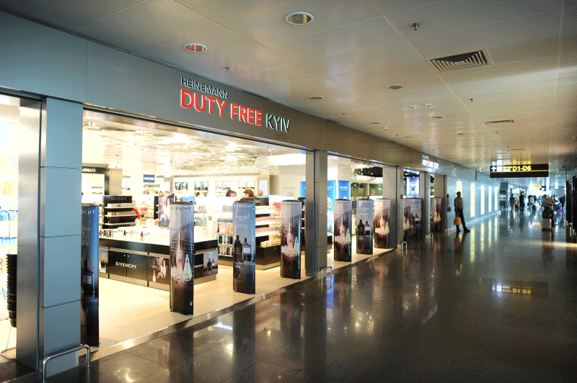
NON-AERONAUTICAL ACTIVITIES
Manage non-aeronautical activities to maximize the potential of the commercial opportunity presented by the airport location
Airports continue to provide services and products that customers wish to buy

Slide 17
TYPES AND OPERATION
Types Of Concessions And Rentals
  Shops and service activities, office and other premises occupied
  Advertising is at the baggage claim area
  Cargo villages where trucking, containerization, warehousing and other cargo activities can be handled on airport property

Slide 18
FREE ZONES
  Exemption of goods imported, exported, stored or processed from any import, export, transit or processing taxes or duties
  Goods produced benefitting from trade agreements to which the State may be party
  Possibility of entering a new market or improving present market position
  Tax exemptions or reductions regarding profits from export business

Slide 19
FREE ZONES
  Freedom to repatriate capital and profits
  Well planned secure zone with newly constructed buildings or sites prepared for construction with all necessary utilities
  Availability of materials, utilities and skilled and non-skilled labour at low cost; and
  Satisfactory air and surface transport services in multimodal transportation

Slide 20
OFF-AIRPORT ACTIVITIES
  Hotels, restaurants, convention centres, shopping centres, freight forwarding agents, warehouses, e-commerce distribution centres, press distribution centres, light industries and surface transportation-related activities
  MROs and Training facilities

Slide 21
MANAGERIAL ASPECTS
Planning and Selection of Non-Aeronautical Activities
  Net revenue
  Net revenue Vs Convenience
  Particularly important at the start of the master planning process

Slide 22
MANAGERIAL ASPECTS
  Conducive to the profitable conduct of non-aeronautical activities. Periodical reviews
  Targets client: passengers, visitors and employees at the airport
  Media

Slide 23
SETTING FEES AND CHARGES FOR NON-AERONAUTICAL ACTIVITIES
Approaches to Determining Market Value
  Tendering procedure
  Similar character in the vicinity of the airport
  Downtown area
  Nature of the trading activity

Slide 24
SETTING FEES AND CHARGES FOR NON-AERONAUTICAL ACTIVITIES
  Size of the market
  Volume of business transacted
  Certain areas or locations within the airport, particularly in the terminal building(s), are commercially much more attractive

Slide 25
SETTING CONCESSION FEES
  Concession fees may be variable or fixed
  Combination of both
  Restaurants, bars, duty-free sales and shops, as well as car rental and car parking operations

Slide 26
FEES FOR CONCESSIONS DIRECTLY ASSOCIATED WITH THE OPERATION OF AIR TRANSPORT SERVICES
  ICAO’s policies on charges (Doc 9082, Section II, paragraph 10)
  Aviation Fuel Concessions
  Ground-handling concessions and ground-handling charges
  POINTS TO BE KEPT IN MIND WHILE ISSUING TENDERS
  Details of the size, location and condition of the premises
  The nature of the activities that could be conducted on the premises

Slide 27
FEES FOR CONCESSIONS DIRECTLY ASSOCIATED WITH THE OPERATION OF AIR TRANSPORT SERVICES
  The proposed date of commencement and duration of the lease
  Maintenance and services provided
  Improvements expected to be carried out by the lessee
  Security or guarantee deposit requirements; and
  Closing date for tender submissions

Slide 28
INFORMATION IN TENDER DOCUMENTS
  Specific information on the type(s) of concessionary activity envisaged, including the variety of merchandise or services to be provided
  Nature of any exclusive trading rights to be granted
  Qualifications and other requirements regarding personnel
  The standards set for merchandise, service, fittings and furnishings

Slide 29
INFORMATION IN TENDER DOCUMENTS
  Nature of furniture and fittings to be provided by the concessionaire
  Insurance requirements
  Data on past traffic volume and predictions for the future
  Past sales figures, if applicable
  Trading hours; and
  Extent of control to be exercised by the airport entity

Slide 30
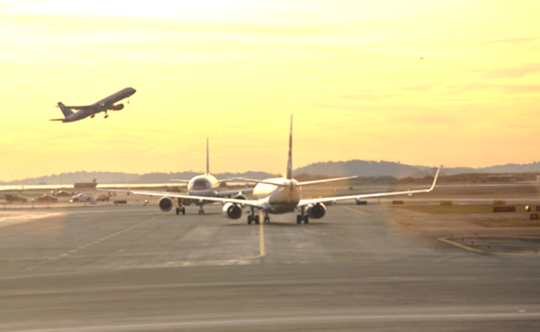
SLOT ALLOCATION AT AIRPORTS
Access rights granted to States under air services agreements (ASAs)
Conference on the Economics of Airports and Air Navigation Services (CEANS)

Slide 31
ICAO AND SLOT ALLOCATION
Study on Regulatory Implications of the Allocation of Flight Departure and Arrival Slots
Liberalizing market access; due consideration to airport capacity constraints
Long term infrastructure needs

Slide 32
ICAO AND SLOT ALLOCATION
Be fair
Non-discriminatory
Transparent
Take into account the interests of all stakeholders
Globally compatible
Maximizing effectiveness
Simple
Practicable

Slide 33
ICAO AND SLOT ALLOCATION
Economically sustainable
Development of model bilateral clauses on slot allocation
Air Transport Regulation Panel (ATRP)
Self-regulation is the traditional and widespread approach
Overall and worldwide schedule co-ordination at twice-yearly IATA meetings

Slide 34
ICAO AND SLOT ALLOCATION
Local co-ordination at individual airports usually through their own scheduling committees
For their winter and summer schedules, normally in June for winter and in November for summer seasons
Historical precedence or ‘grandfather rights’ (an airline can keep a slot previously allocated if it has operated it)
Use it or lose it’ – if an airline used an allocated slot less than a certain proportion of time, it is given to someone else

Slide 35
ICAO AND SLOT ALLOCATION
Priority for regular services – if there is competing demand, it will be allocated to the service that plans to use it most frequently.
Services of longer duration get preference over those that are of shorter duration (i.e. a year-round service would have priority over a summer-only service)

Slide 36
ICAO AND SLOT ALLOCATION
Services operated on more days of the week have priority
Airlines can exchange slots among themselves provided they have broadly similar operating characteristics
An individual airline can also change the use of its own slots; switching a slot from a domestic to international service or from scheduled to charter

Slide 37
CONCLUSION
Airlines are users of services at an airport while they are service providers to the customers
Airport management is a service provider
Any issue even with the airlines, security, customs, other concessionaires can damage the reputation of an airport
Airport managers need to create an environment conducive for participative and collaborative functioning
Customers’ satisfaction is the final objective

